Slide 1
Enough with data overflow – build data products
Jarkko Moilanen (PhD)
Chief Development Officer, Platform of Trust
@Jarkko_Moilanen
+358 40 535 9066

Slide 2

100 Days DX 100daysdx.com
100 articles on what is Developer eXperience.
The biggest open resource on Developer eXperience so far.
Economics of the Developer eXperience
Why DX matters in product development and sales
DX Doctor – dxdoctor.net – Jarkko Moilanen @Jarkko_Moilanen

Slide 3

Exploration of ideas and concepts
Theme triangle of the session
API
DX
Developer
Data Product
DX Doctor – dxdoctor.net – Jarkko Moilanen @Jarkko_Moilanen

Slide 4
Collect data, data lakes, data driven decision making, it’s all about data
DX Doctor – dxdoctor.net – Jarkko Moilanen @Jarkko_Moilanen

Slide 5
Collect data, data lakes, data driven decision making, it’s all about data
Just collecting data does not make your company any more agile, data driven, generate more revenue or anything else.
…you just burn shit loads of money
DX Doctor – dxdoctor.net – Jarkko Moilanen @Jarkko_Moilanen

Slide 6
Collect data, data lakes, data driven decision making, it’s all about data
Instead treat data as products. Refine, commoditize, and package it for internal and public consumption.
…you still burn shit loads of money, but now you do it to make more money
Decent data product definition is missing in academic literature
DX Doctor – dxdoctor.net – Jarkko Moilanen @Jarkko_Moilanen

Slide 7
Product management
DX Doctor – dxdoctor.net – Jarkko Moilanen @Jarkko_Moilanen

Slide 8

A lot of companies did not understand until lately that APIs need to be treated as products.
That is, apply product management in APIs too.
Same is happening with data.
Data must be productized even if it is used only internally (internal APIs), if it is used by partners (Partner APIs) or if data is offered to be consumed by anyone (public APIs).
Product management
DX Doctor – dxdoctor.net – Jarkko Moilanen @Jarkko_Moilanen

Slide 9
Generic "we have it all" bloated APIs never became a success.
Instead those APIs that were focused and compact solutions for a need won the game.
DX Doctor – dxdoctor.net – Jarkko Moilanen @Jarkko_Moilanen

Slide 10
Applications are not built with one API. Plethora of APIs are used. Applications will not use just one data source either.
Instead applications will consume multiple specific for purpose-built data products
DX Doctor – dxdoctor.net – Jarkko Moilanen @Jarkko_Moilanen

Slide 11
Data Product
DX Doctor – dxdoctor.net – Jarkko Moilanen @Jarkko_Moilanen

Slide 12
Data Product Definition
A data product is the item offered for sale. A data product is a commodity. Every data product is made at a cost and each is sold at a price. The price that can be charged depends on the market, the quality, the marketing and the segment that is targeted. Each product has a useful life after which it needs replacement, and a life cycle after which it has to be re-invented.
DX Doctor – dxdoctor.net – Jarkko Moilanen @Jarkko_Moilanen

Slide 13
A data product needs to be relevant the users must have an immediate use for it. A product needs to be functionally able to do what it is supposed to, and do it with a good quality.
A data product needs to be communicated Users and potential users must know why they need to use it, what benefits they can derive from it, and what it does difference it does to their lives. Advertising and 'brand building' best do this.
A data product needs a name a name that people remember and relate to. A product with a name becomes a brand. It helps it stand out from the clutter of products and names.
A product should be adaptable: with trends, time and change in segments, the product should lend itself to adaptation to make it more relevant and maintain its revenue stream.
Data Product
DX Doctor – dxdoctor.net – Jarkko Moilanen @Jarkko_Moilanen

Slide 14
APIs and Data
DX Doctor – dxdoctor.net – Jarkko Moilanen @Jarkko_Moilanen

Slide 15
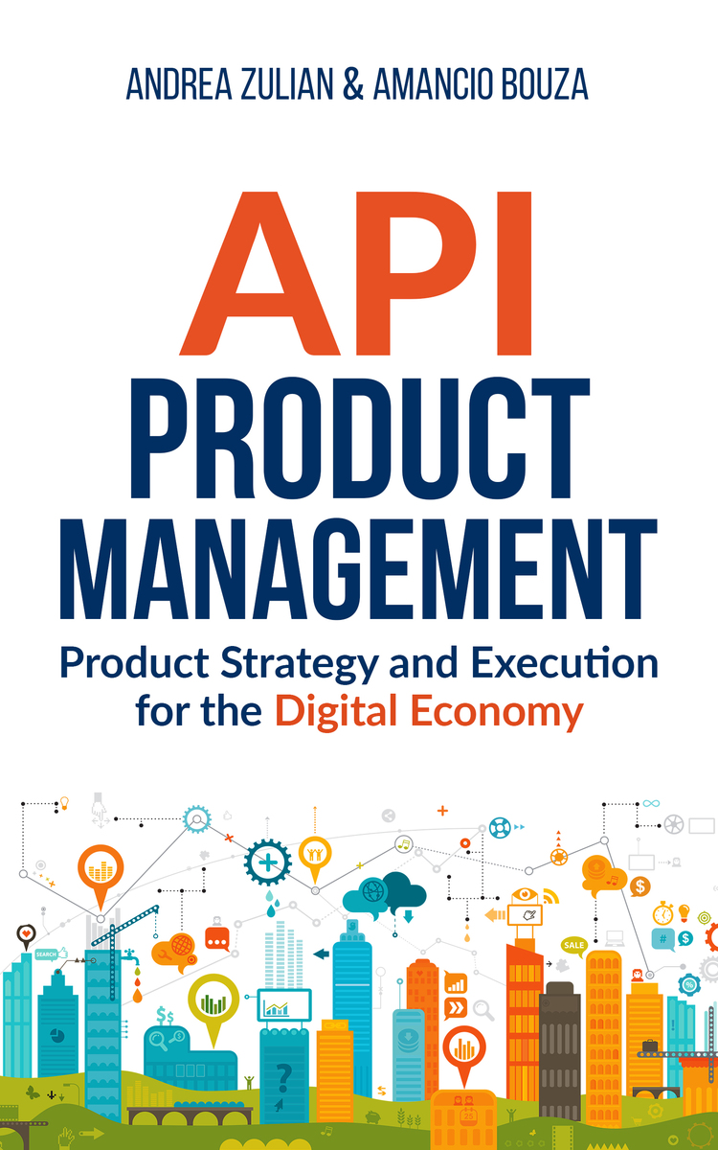
”Ultimately, the API is only about the interface to the value proposition, not to the application.”
Data
Economy
API
Economy
Amancio Bouza
Payload
API
System
B
Payload
Payload
DX Doctor – dxdoctor.net – Jarkko Moilanen @Jarkko_Moilanen

Slide 16

Applications require multiple APIs and data sources
Payload
API
System
A
Payload
Each system has their own data model.
Each data model changes in different schedules.
This causes continuous chaos at the application adaptation.
Each system has differently designed API
Even if all the systems should give me CO2 levels in the rooms of one building
As a developer I’m in tears…
Payload
Payload
API
System
B
Payload
Payload
Payload
API
System
C
Payload
Payload
DX Doctor – dxdoctor.net – Jarkko Moilanen @Jarkko_Moilanen

Slide 17
Lets go back a little and eventually combine all to one drawing…
DX Doctor – dxdoctor.net – Jarkko Moilanen @Jarkko_Moilanen

Slide 18
Integration
Application
Application
Application
Application
Data set
Data set
Data set
Data set
DX Doctor – dxdoctor.net – Jarkko Moilanen @Jarkko_Moilanen

Slide 19
API
Application
Application
Application
Application
API
Data set
DX Doctor – dxdoctor.net – Jarkko Moilanen @Jarkko_Moilanen

Slide 20
Data products driven thinking
Internal data products
Partner data products
Public data products
Open data data products
Internal Application
Partner Application
3rd party Application
Any application
API
Market place
Internal Data Product
Partner Data Product
Public Data Product
Open Data Data Product
Connect and harmonise data
System 2
System 3
System 1
more
more
DX Doctor – dxdoctor.net – Jarkko Moilanen @Jarkko_Moilanen

Slide 21
DX Doctor – dxdoctor.net – Jarkko Moilanen @Jarkko_Moilanen

Slide 22
Data product management
Build data products for purpose
Standardize access to data
Standardize payload (content)
Target group fitting pricing model and rights (know your customer)
Contantly improve and analyze the usage (product-market fit)
…
DX Doctor – dxdoctor.net – Jarkko Moilanen @Jarkko_Moilanen

Slide 23
Data products chart v1
Publicly available?
Public onboarding material?
Paid plan?
Content under open license?
Open data data product
YES
YES
MAYBE
YES
Open data product
Public data product
YES
YES
MAYBE
MAYBE
Partner data product
NO
YES
MAYBE
NO
Private / internal data product
NO
NO
NO
NO
DX Doctor – dxdoctor.net – Jarkko Moilanen @Jarkko_Moilanen

Slide 24
You should collect data in lakes or what ever hype term you want to use here
Treat data as products. Refine, commoditize, and package it for internal and public consumption.
DX Doctor – dxdoctor.net – Jarkko Moilanen @Jarkko_Moilanen

Slide 25
Theme of the session
API
Developer
Data Product
DX Doctor – dxdoctor.net – Jarkko Moilanen @Jarkko_Moilanen

Slide 26
Enough with data overflow – build data products
Jarkko Moilanen (PhD)
Chief Development Officer, Platform of Trust
@Jarkko_Moilanen
+358 40 535 9066

Slide 27
Available for API development and strategy consulting
+358 40 535 9066
dxdoctor.net/services

